Slide 1
BADM 567: Process Management
Module 4: Supply Chain Management
Gopesh Anand

Slide 2
Today’s Session
SCM Issues in the News
Outsourcing and Vertical Integration
Bergerac Systems: The Challenge of Backward Integration
Managing Supply Chain Risk

Slide 3

Triple Threat: Covid, Conflict, Climate
https://news.un.org/en/story/2022/07/1122112
https://youtu.be/pwafOKQ_szQ

Slide 4
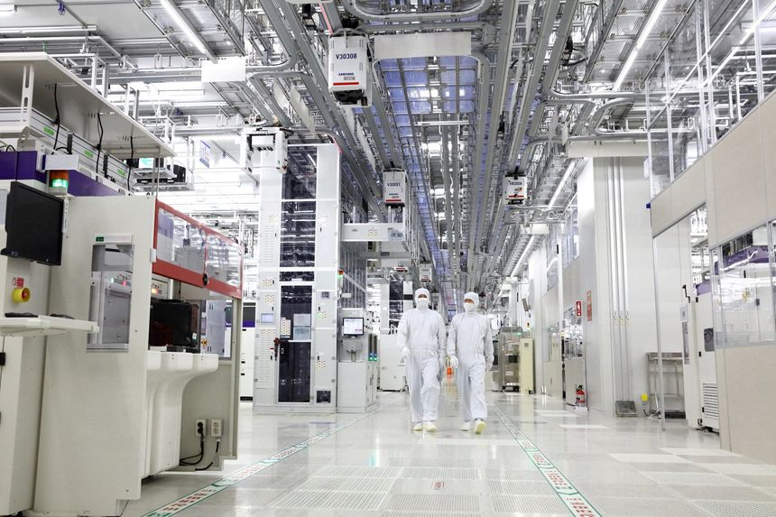
Memory-Chip Makers Face a Prolonged Price Slump
By Jiyoung Sohn, Jan. 30, 2023
https://www.wsj.com/articles/memory-chip-makers-face-a-prolonged-price-slump-11675081634?mod=djemalertNEWS

Slide 5
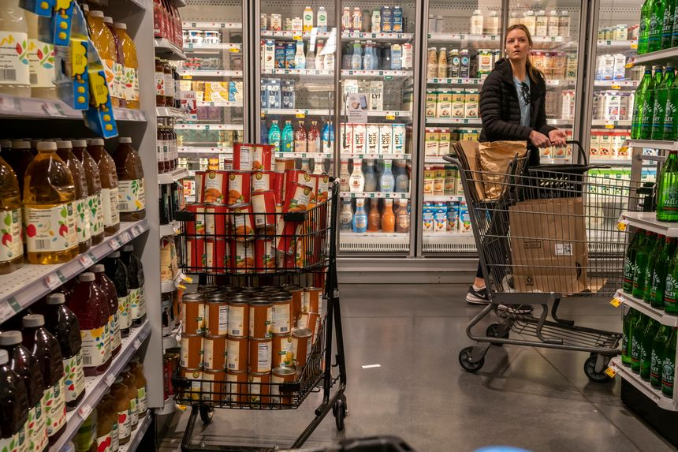
Whole Foods Asks Suppliers to Lower Prices
By Jaewon Kang, Jan. 31, 2023
https://www.wsj.com/articles/whole-foods-asks-suppliers-to-lower-prices-as-costs-ebb-11675115155?mod=djemalertNEWS

Slide 6


Relevant Book
Arriving Today: From Factory to Front Door -- Why Everything Has Changed About How and What We Buy
by Christopher Mims
Documentary Why Global Supply Chains May Never Be the Same
Released March 23, 2022

Slide 7
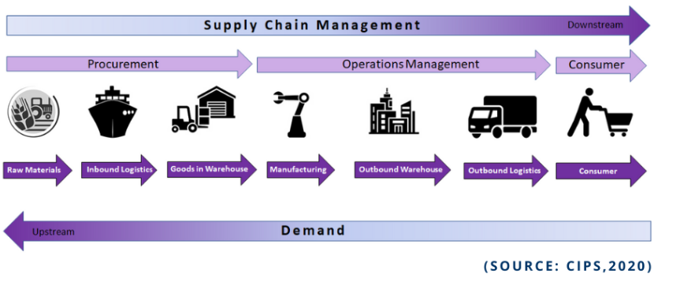
Supply Chain
https://www.cips.org/knowledge/procurement-topics-and-skills/supply-chain-management/what-is-a-supply-chain/

Slide 8
Outsourcing
Passing on an organizational activity completely or partially to an external supplier
Outsourcing can be offshore or onshore
Barthélemy, J. (2003), "The seven deadly sins of outsourcing", Academy of Management Executive, Vol. 17 No. 2, pp. 87-100
Gottfredson, M., Puryear, R. and Phillips, S. (2005), "Strategic sourcing: from periphery to the core", Harvard Business Review, Vol. 83 No. 2, pp. 132-139.
Venkatraman, N. V. (2004), "Offshoring without guilt", MIT Sloan Management Review, Vol. 45 No. 3, pp. 14-16
Gray, J. V., Skowronski, K., Esenduran, G., & Johnny Rungtusanatham, M. (2013). The reshoring phenomenon: what supply chain academics ought to know and should do. Journal of Supply Chain Management, 49(2), 27-33.
Harrigan, K. R. (1986). Matching vertical integration strategies to competitive conditions. Strategic Management Journal, 7(6), 535-555.

Slide 9
Vertical Integration
Bringing in, part of the supply chain, into your own company
Forward integration
Bringing into the company, activities from lower levels of the supply chain.
Example: Amazon using its own trucks instead of UPS
Backward integration
Bringing into the company, activities from upper levels of the supply chain.
Example: Netflix producing its own movies

Slide 10



Bergerac Systems The Challenge of Backward Integration

Slide 11
Poll Question #1 - True/False
Bergerac’s customers are mainly laboratories that do testing for veterinary clinics.
How is this relevant?

Slide 12

Related Recent News: Handheld Ultrasound
Sound Technologies and GE HealthCare Announce Collaboration to Bring Vscan Air to Veterinary Practices Across the United States
January 26, 2023
Thank you, Christine Liautaud, for sending this story
https://investor.gehealthcare.com/news-releases/news-release-details/sound-technologies-and-ge-healthcare-announce-collaboration
https://soundvet.com/ultrasound/vscan-air/

Slide 13

Nature of Bergerac’s Products
https://pixabay.com/photos/razor-razor-blades-shave-hygiene-587625/

Slide 14




Ultimate Customers: Pet Owners
Mini
Zefir
Lizzie
Thank you, Kaylin
Thank you, Rahul

Slide 15
Poll Question #2 - True/False
The market for Bergerac’s products is relatively unchanging.

Slide 16
Product Innovations
Smaller, simpler devices
Home visit market

Slide 17
Projected Sales Outlook for Cartridges?
Current: 4.7 million
Expected annual growth rate of 10%
In five years, 7.5 million
Incorporating growth in market share, so 15%
In five years, 9.4 million

Slide 18
Describe Bergerac’s Operations and Supply Chain
Located in Parsippany
HemaVue and OmniVue instruments
Single-source suppliers
Proprietary single-use animal-specific cartridges
Injection molded plastic – base and cover
Chemical reagents in multiple chambers

Slide 19
Poll Question #3 - True/False
Bergerac is considering integrating a chain of veterinary clinics into its existing business.
What are their options?

Slide 20
Poll Question #4 - True/False
Acquiring GenieTech will not be adequate for fulfilling current demand.

Slide 21
The Numbers
 | GenieTech | In-House
Molds of 10 units | 8 | 4
Cycle Time (Seconds) | 75 | 70
Cycles per 8 hour shift | 384 | 411
Parts per shift | 30,720 | 16,457
Cartridges per Shift (Cover + Base) | 15,360 | 8,229
Machine up-time | 90% | 95%
Cartridges per Shift | 13,824 | 7,817
Annual Cartridge Capacity | 10,368,000 | 5,862,857
Based on 3 shifts * 5 days * 50 weeks

Slide 22
What Other Aspects of Acquire vs In- House Should Bergerac Consider?
Acquiring requires integration of GenieTech
Acquiring will result in over-capacity while In-House will need to be expanded soon
In-House requires specialized knowledge in injection molding
In-House brings in newer machines – better yield

Slide 23
Poll Question #5 – Multiple Choice
What do you recommend?
Acquire GenieTech
Build In-House Capacity
Other

Slide 24
Make vs Continue to Buy
Making will create co-location or captive supplier (Hershey, Pennsylvania)
Will making get rid of unreliable delivery?

Slide 25
Framework
Make | Buy
Tacit knowledge – Hard to communicate and requires doing | Codified knowledge – Can be communicated easily through words and diagrams
Unique research and development (R&D) for specific use of a company | Common research and development (R&D) with uses for many companies
Weak protections for intellectual property (IP) | Strong protections for intellectual property (IP)
Theory: Transaction Cost Economics
Hayes, R., Pisano, G. P., Upton, D. M., & Wheelwright, S. C. (2005). Operations. Strategy and Technology: Pursuing the Competitive Edge, New York.
Williamson, O. E. (2008). Outsourcing: Transaction cost economics and supply chain management*. Journal of supply chain management, 44(2), 5-16.

Slide 26
Middle Road
Arms-length
Buy
Supply Partnerships
Vertical Integration
Make

Slide 27
Modify Buying Arrangements
Make some, buy some
Supplier partnerships and contracts
Cover the raw material risk for the suppliers
Scherrer-Rathje, M., Deflorin, P., & Anand, G. (2014). Manufacturing flexibility through outsourcing: effects of contingencies. International Journal of Operations & Production Management.

Slide 28
Build Relationships
Reduce supplier base and deepen relationships
Provide continuous feedback at all levels
Share information systematically
Involve suppliers in quality management
Liker, J. K., & Choi, T. Y. (2004). Building deep supplier relationships. Harvard business review, 82(12), 104-113.

Slide 29
Supply Chain Design
Supply Uncertainty |  | Demand Uncertainty
 |  | Low (Functional Products: groceries, food) | High (Innovative Products: fashion goods, computers)
 | Low (Stabilized Processes) | Efficient | Responsive
 | High (Emerging Processes) | Risk-Hedging | Agile
Fisher, M. L. (1997). What is the right supply chain for your product?. Harvard business review, 75, 105-117.
Lee, H. L. (2002). Aligning supply chain strategies with product uncertainties. California management review, 44(3), 105-119.

Slide 30
Managing Supply Chain Risk

Slide 31
Sources of Risk
Natural disasters
Transportation disruptions
Political disturbances
Others…
For example:
https://www.cbsnews.com/news/suez-canal-ship-stuck-ever-given-unstuck/

Slide 32
Supply Chain Resilience
Ability to quickly respond to unexpected disruptions in supply or demand, either natural or manmade.
Examples: strike, recession, sudden price change, natural disaster, manufacturing failure, unexpected demand.

Slide 33
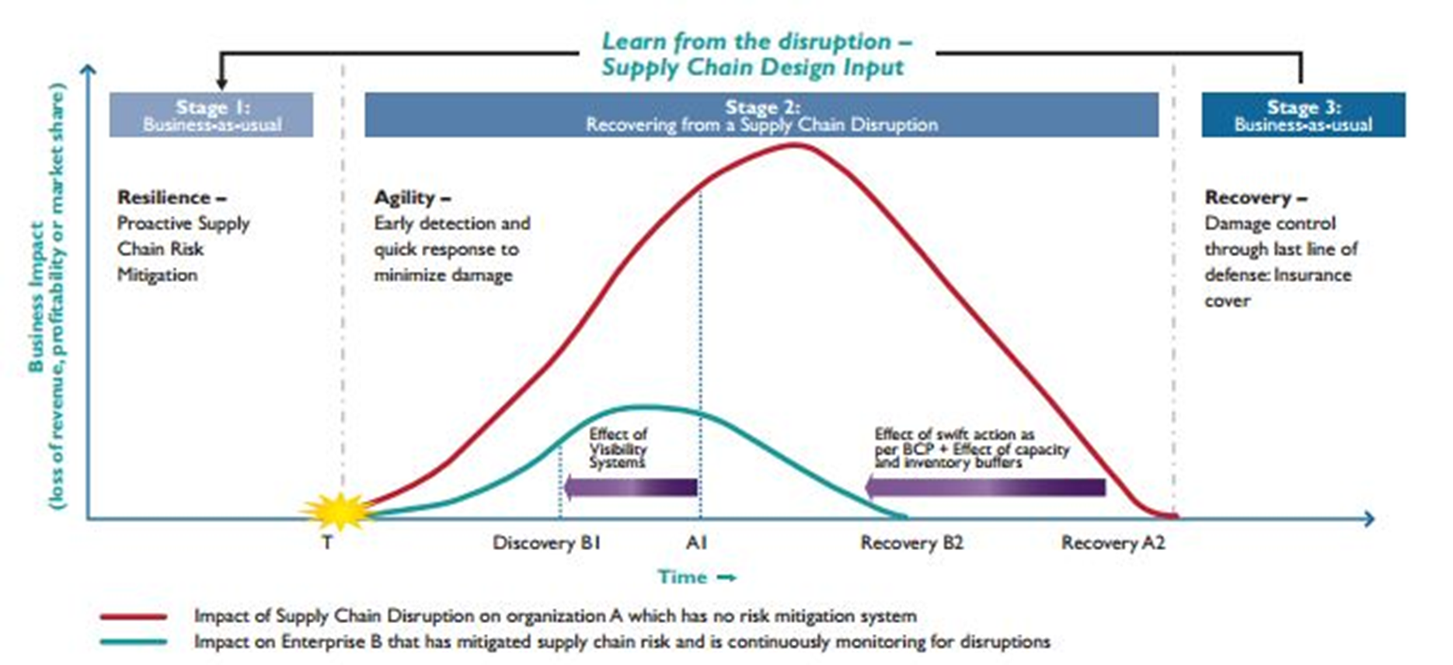
Risk Mitigation Systems
https://www.wipro.com/consulting/supply-chain-vulnerability-in-times-of-disaster/

Slide 34
Steps Toward Supply Chain Agility
Educate and protect employees
Plan around absenteeism and closures
Focus on immediate suppliers (tier 1) first
Explore alternative supply sources
Increase agility in scheduling

Slide 35
Map Your Supply Chain
Start with bill of materials of top five products
Focus on key components
Drill down to their component suppliers – all the way down to raw materials vendors
Include information on alternate sites of the supplier for same activity or product
https://hbr.org/2020/03/coronavirus-is-a-wake-up-call-for-supply-chain-management

Slide 36
Preparing For Future Disruptions
Transparency
Data
Investment in employees
Reward more than cost efficiency
Conduct stress tests
Push for uniform regulations
FDA, EPA, OSHA, IPR

Slide 37
Technological Developments
https://youtu.be/VdFx2R6diMk
Blockchain – connecting flows of inventory, information, and money
Big Data – large data sets
Internet of Things – everything connected to the internet
Artificial Intelligence – intelligence exhibited in machines
Machine Learning – AI application for learning from data
Sharing Economy – Economic system that shares assets and services (e.g., Airbnb, Crowdfunding)

Slide 38
Looking Forward
Process Improvement
Information about Timed Quiz/Exam on Canvas - Module 4
Thank you!

